Slide 1



Taylor B. Harkins
The mental health epidemic won’t be solved by Human Resources alone — it requires real authentic leadership. When leaders listen, share, and act with compassion, they don’t just manage teams — they save lives.

Slide 2
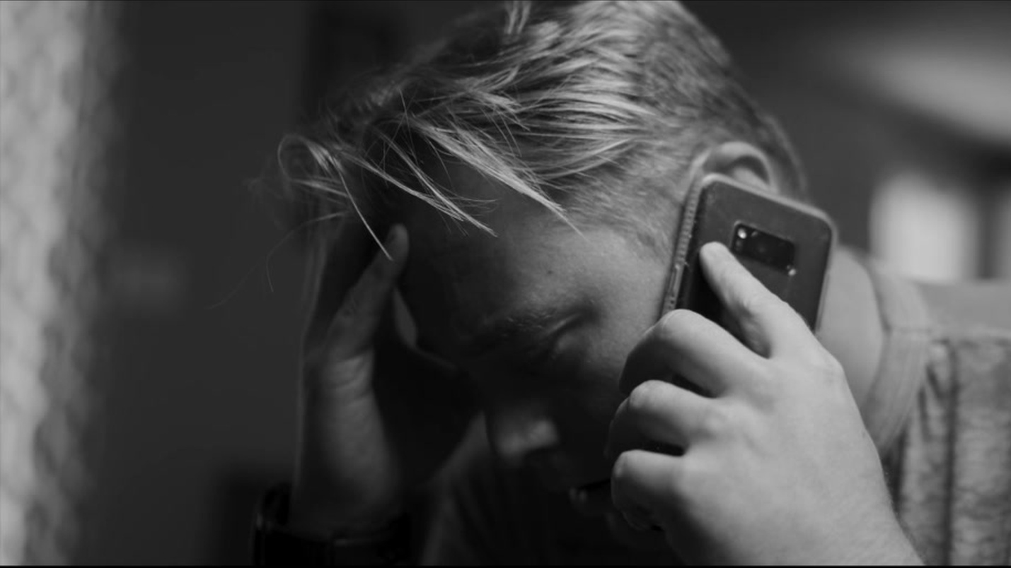
988 and Rosendin’s Commitment to Employee Well-Being
Know 988 like you know 911. It could save a life.

Slide 3





Slide 4
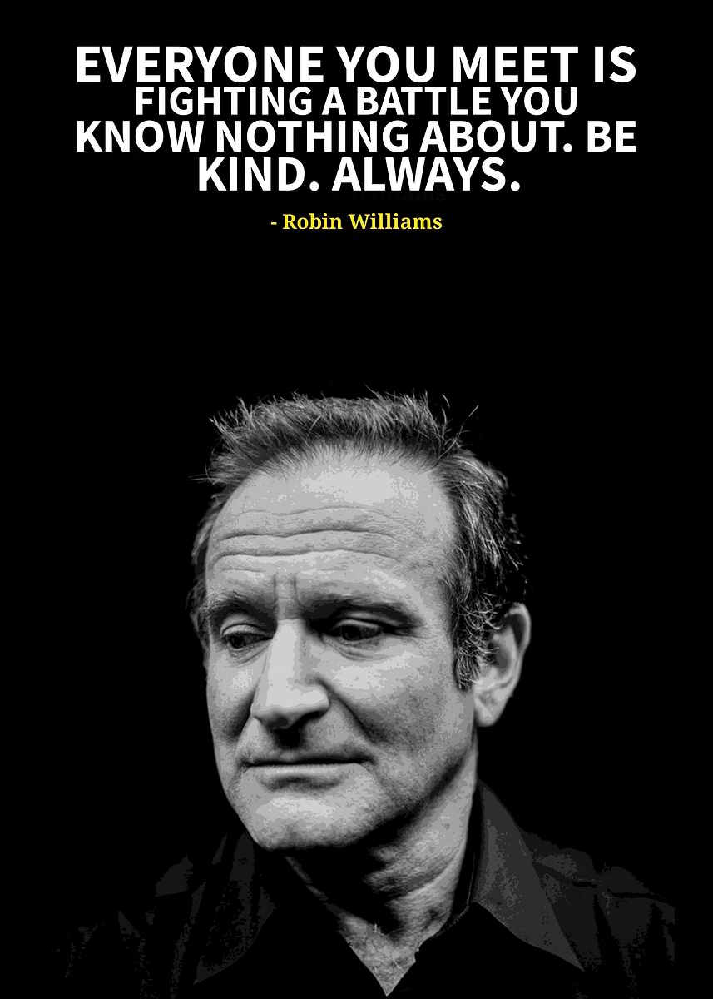

Slide 5
“Caring for people is one of our core values at Rosendin. We understand the importance of prioritizing mental health in the construction industry and worldwide. That’s why we have enhanced our training on the topic, expanded care through qualified providers, and continuously look for ways to support our employees and their families through difficult times.”
Keith Douglas, CEO Rosendin Holdings, Inc.

Slide 6

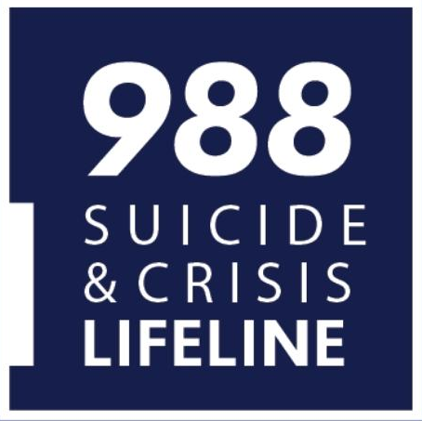
988 is the Suicide & Crisis Lifeline. 100% confidential. Available 24/7 for anyone experiencing a mental health crisis, including hearing impaired (text, call, or chat via 988lifeline.org). Provides immediate connection to trained crisis counselors. Free and accessible nationwide.

Slide 7

Why 988 Matters in the Workplace
Construction industry faces higher rates of suicide than most sectors
Many employees and families experience stress, anxiety, and depression
Empowering employees with 988 can save lives (24/7, confidential, and free resource)
Demonstrates our commitment to safety and well-being beyond physical health

Slide 8
CONSTRUCTION-SPECIFIC-RISK FACTORS
WARNING SIGNS
Changes in appearance
Reported changes in sleep
Increase substance abuse and other risky/escape behaviors
Change in social patters (e.g., withdrawn)
Agitation, irritation, anger, cynicism, violence, mood swings
Increased absenteeism or presenteeism
Increased errors or incidents
Increased conflict and lowered stress tolerance
Self-doubt, self loathing, feeling like a burden
Hopelessness, purposelessness, feeling trapped
Increased errors or incidents
Changes in appearance
Reported changes in sleep
Increase substance abuse and other risky/escape behaviors
Change in social patters (e.g., withdrawn)
Agitation, irritation, anger, cynicism, violence, mood swings
Increased absenteeism or presenteeism
Increased errors or incidents
Increased conflict and lowered stress tolerance
Self-doubt, self loathing, feeling like a burden
Hopelessness, purposelessness, feeling trapped
Increased errors or incidents
From Construction Working Minds -- a Program of Dr. Sally

Slide 9


Engaged an expert in Mental Health to conduct Train-the-Trainer sessions, establish Ground Crew units, and provide general awareness training Robust CIGNA EAP Program (available 24/7) and includes 10 free counseling sessions for employees and household members Toolbox Talks: Field leaders equipped with toolbox talks on mental health and warning signs Mental Health marketing campaigns to build awareness around the warning signs Educating employees about 988 and how it can save a life
Rosendin’s Commitment to Mental Health

Slide 10

Taking Action TOGETHER
Check on your people! If something doesn’t seem right, it probably isn’t.
Awareness without action isn't enough. TRAIN your managers and encourage them to train their direct reports.
Remove the stigma through Storytelling!
When leaders model vulnerability, it gives everyone else permission to be human.
Make resources visible & accessible.
Promote a healthy workforce. Encourage time-off and a healthy work-life balance.
Healthy teams outperform burnt-out ones. Productivity and well-being are not competing priorities.

Slide 11

Know 988 like you know 911. It could save a life! Be the change. Know the warning signs!
Challenge for All of You

Slide 12

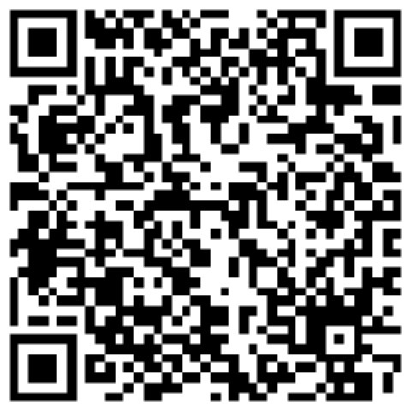
Taylor B. Harkins, sHRBP, SWP, ELC
Connect with me on LinkedIn!

